Slide 1
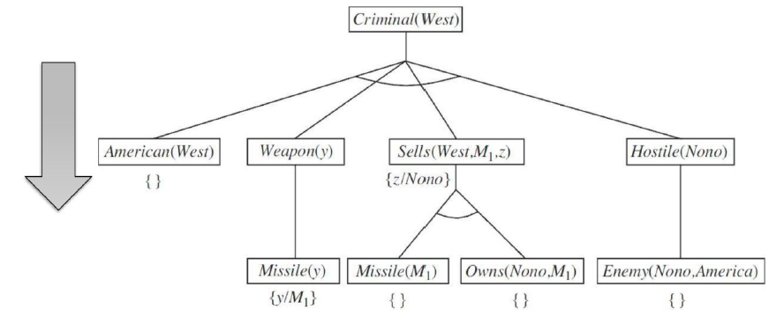
Backward Chaining
Start with goal sentence; search for rules that support goals, adding new sub-goals until
match with KB facts or no further inference can be made.

Slide 2
Backward Chaining - Steps
Step 1: Take the goal fact. And from the goal fact, we will infer other facts, and at last, we will prove those facts true.
Goal: West is Criminal

Slide 3
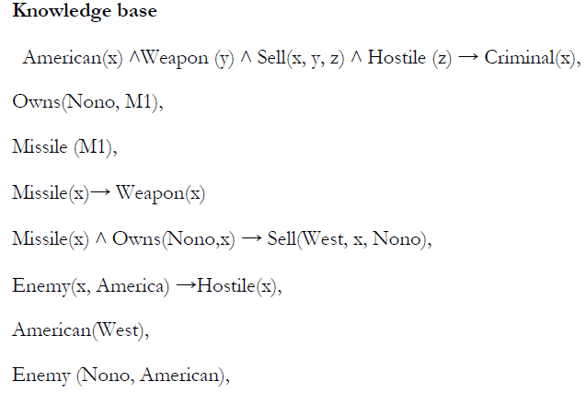
Backward Chaining - Steps
Step 2: we will infer other facts form goal fact which satisfies the rules.

Slide 4
Backward Chaining - Steps
Step 3: we will infer other facts form goal fact which satisfies the rules.

Slide 5
Backward Chaining - Steps
Step 4: extract more facts from predicates.

Slide 6
Backward Chaining - Steps
Step 5: infer the last fact (Enemy and Hostile). Hence, all statements are proved true.

Slide 7
To be continued …
Thank You

